Slide 1
INFO6150 - Final Presentation Easy Homes
Aishwarya Samel
Ajay Prasad
Nakul Deshpande
Sayali Mahajan

Slide 2
Background
Buying the best home is a dream for every person. Easy Homes helps in finding that best home for you globally by sitting on couch. While there are so many properties getting build everyday, visiting each property as per your requirement is a tedious task. In addition to that multiple parties are involved in this process that can work virtually.
Easy Homes is a web-app that helps in buying and selling homes online without visiting the property especially in this covid times.

Slide 3
Benefits Served
Enhanced Customer Support
Customizable
Increases speed of sales process
Easy Platform for customers
Online payment feature
Application Data Statistics using Charts and graph.
Google login integration for customer

Slide 4
Contribution
Sayali – Google Authentication, Chart JS, Session Management, Admin , Signup, Frontend Integration
Aishwarya – Property Details, User Profile, Sign In, Backend server setup, FAQ
Ajay – Property Listing, Filters , E2E Testing, Home Page, SCSS styling
Nakul – Add Property, SCSS styling, ReactJS, PayPal Integration
All Members of team showed equal participation in all the phases of project development

Slide 5
Features
ReactJs and Redux.
Node.js Express Architecture with CORS
Mongoose to interact with MongoDB Database.
MongoDB aggregation pipeline.
Chart JS library to display live Data Statistics
Cloudinary API to upload images to cloud
Easy integration with web and mobile apps.
Flow for User Signup & User Login including Google authentication

Slide 6
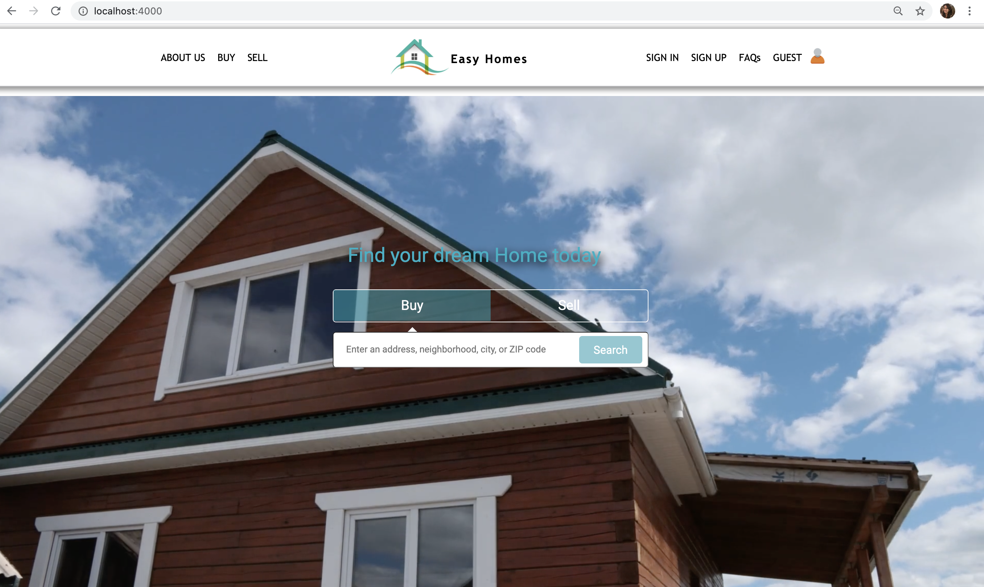
Home Page

Slide 7
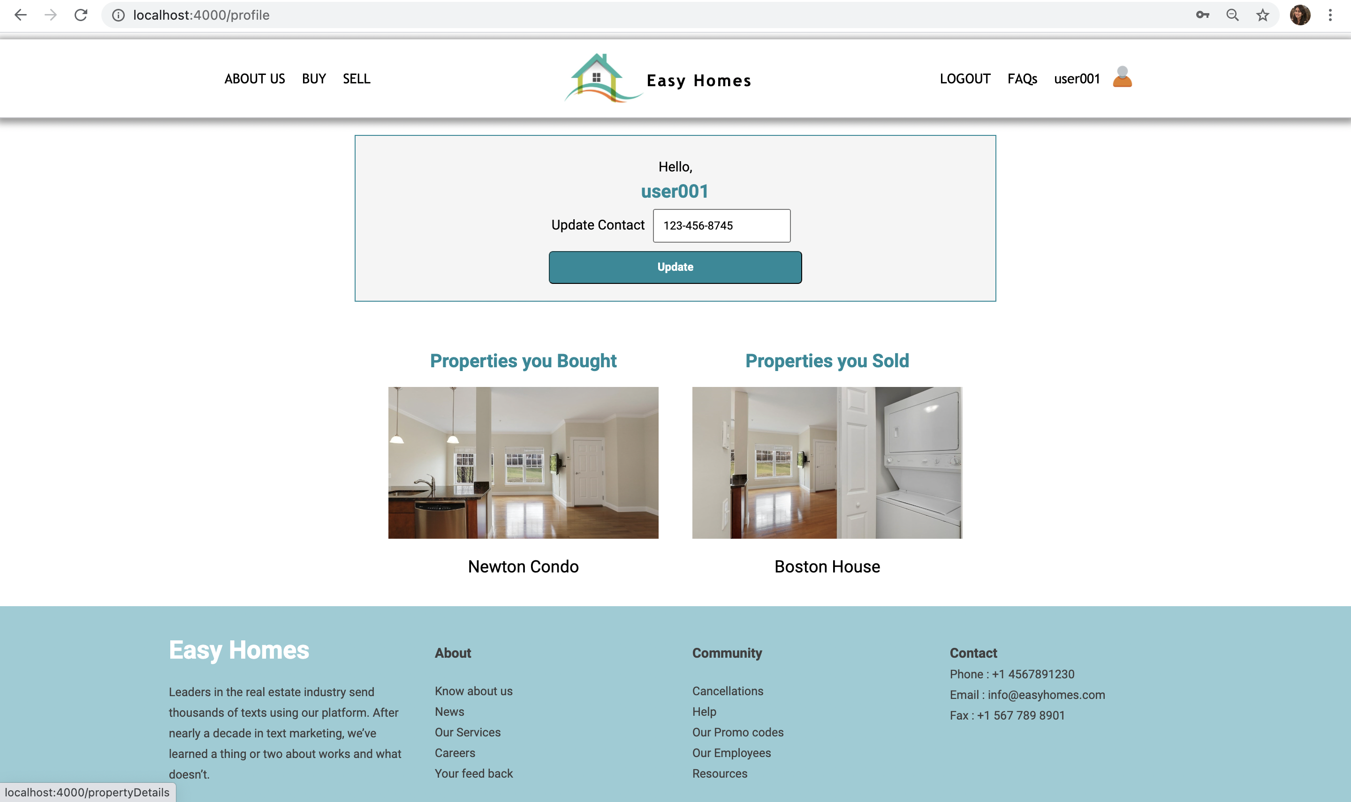
User Profile

Slide 8
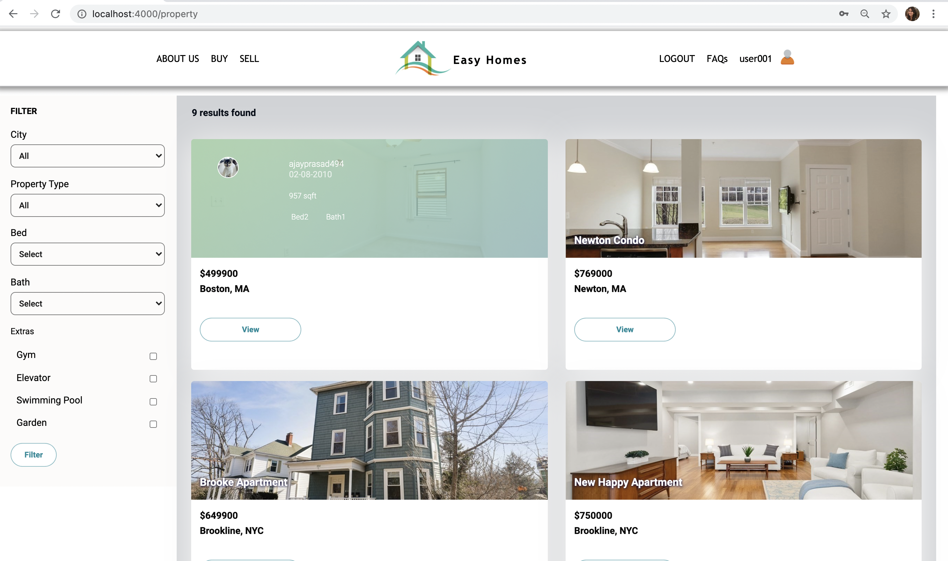
Property Listing

Slide 9
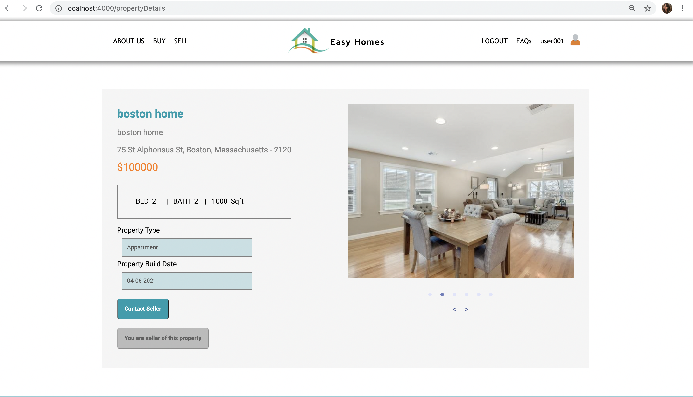
Property Detail

Slide 10
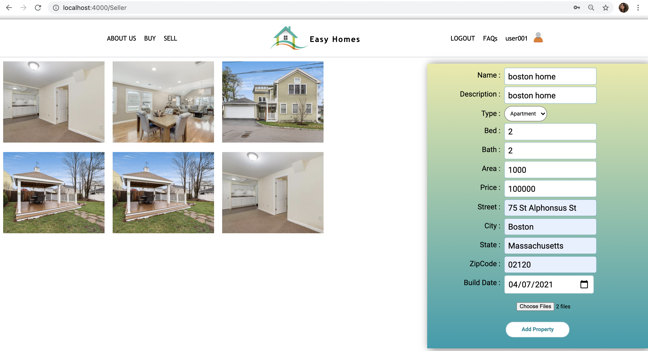
Add Property

Slide 11
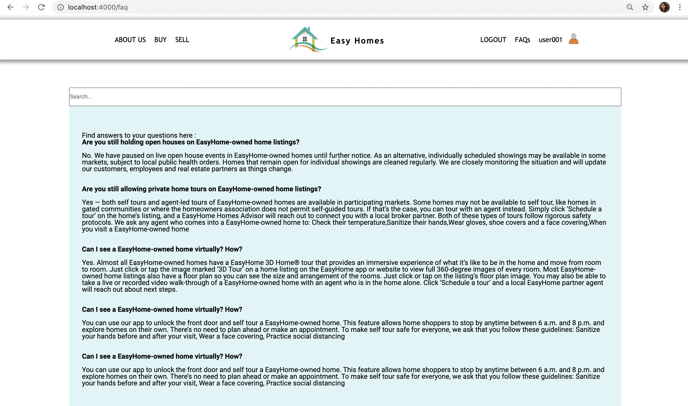
FAQ Page

Slide 12
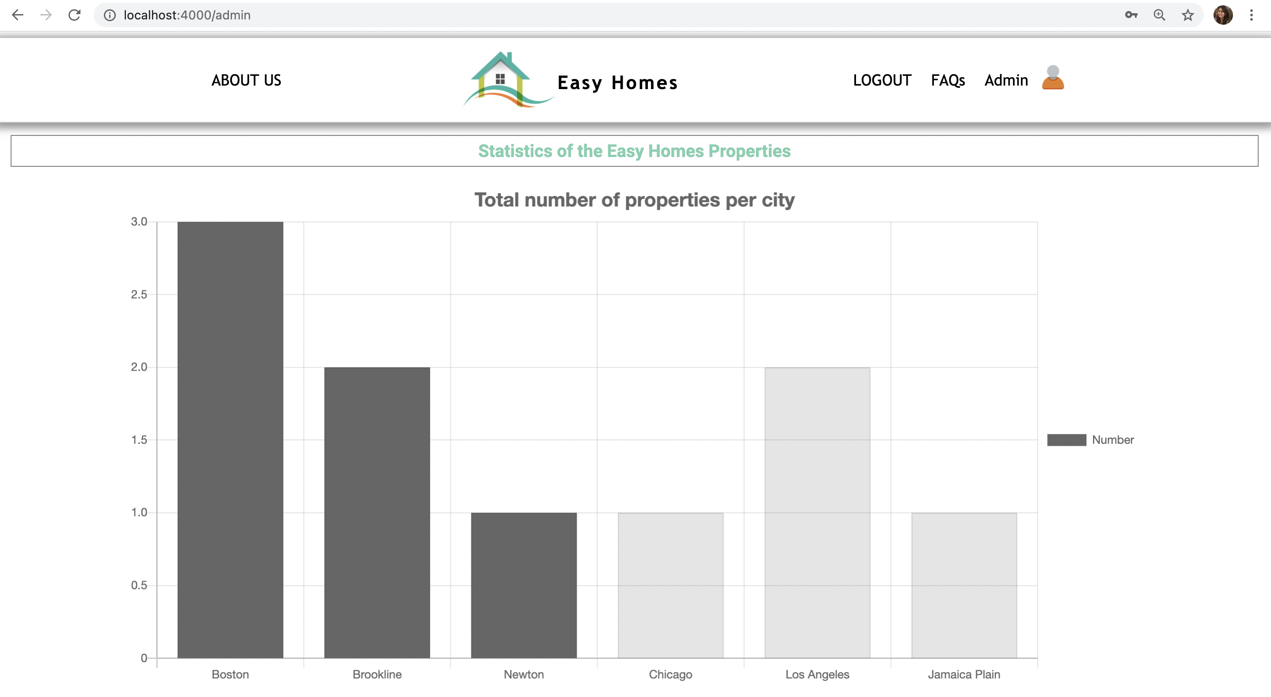
Admin page 1

Slide 13
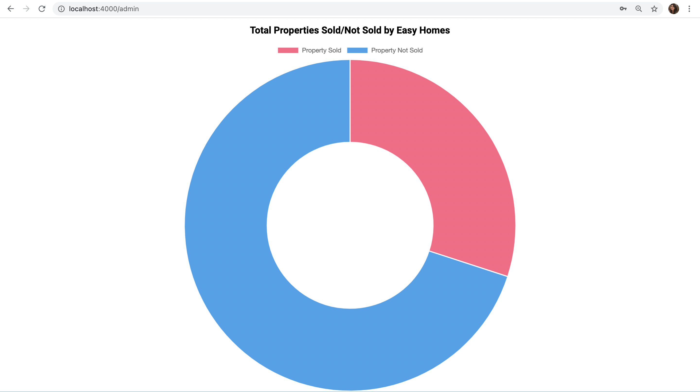
ADMIN Page 2

Slide 14
References
https://blog.logrocket.com/handling-images-with-cloudinary-in-react/
https://www.createwithdata.com/react-chartjs-dashboard/
https://www.youtube.com/watch?v=LA16VCpUido
https://www.bmc.com/blogs/mongodb-compass/
https://docs.mongodb.com/manual/aggregation/

Slide 15
Thank You!

